Slide 1
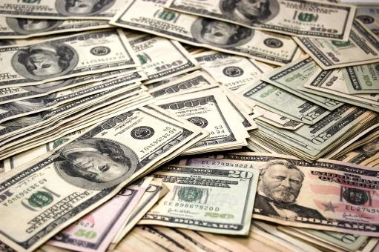
By: Yohann Nilo A. Udtohan and Liam Xandre G. Nacaytuna

Slide 2
Project Introduction:
Project Description:
This is a simple Python project that helps you to accurately and precisely track your finances, such as your current balance as well as your transactions, among other things.
Project’s Objective:
a. To develop a financial tracker/manager that can accurately and precisely record and categorize incomes and expenses in the Python coding language.
b. To provide real-time monitoring of said data to help users to reflect and build on their previous financial decisions and activities.
c. To hopefully benefit the user’s financial state by also providing other features that focus on other areas of finance such as budgeting
Target Users:
The users targeted by this application are those in either financial distress or in need of precise and accurate financial tracking.

Slide 3
Planned Features:
Project Introduction:
1. Checks and Balances
This feature aims to show you your current balance in either your checking or spending account or your savings account.
Automatically updates after every transaction done in the other features.
3. Transaction Archive
- Stores all transactions in chronological order
- Displays transaction information in a predefined format(Date of Transaction – short description)
Project Description:
5. Currency Converter
- This aims to convert the amount of pesos you have into a widely-used currency.
- Currencies supported:
a. United States Dollar
b. Euro
c. Japanese Yen
d. British Pound Sterling
e. Australian Dollar
f. Canadian Dollar
g. Singapore Dollar
h. South Korean Won
i. Chinese Yen
j. Hong Kong Dollar
k. Qatari Dirham
This is a simple Python project that helps you to accurately and precisely track your finances, such as your current balance as well as your transactions, among other things.
Project’s Objective:
a. To develop a financial tracker/manager that can accurately and precisely record and categorize incomes and expenses in the Python coding language.
b. To provide real-time monitoring of said data to help users to reflect and build on their previous financial decisions and activities.
c. To hopefully benefit the user’s financial state by also providing other features that focus on other areas of finance such as budgeting
2. Transaction Station
- Allows user to record financial activities such as income transactions and expense transactions.
- Required inputs include:
a. Date of Transaction: (year – month – day)
b. Account type to be used for transaction (checking/savings)
c. Type of transaction (income/expense)
d. Amount of pesos earned/lost
e. A brief description of the transaction
f. Optional: Physical or image proof of that transaction
- Updates balance automatically after transaction follows through
4. Balance Calculator
- Helps user figure out time needed to achieve a certain financial goal
- Formula used: (Target Balance) / (Monthly Income – Monthly Expense)
- If not a whole month, it rounds up to days
- Displays error message if expenses exceed income
Target Users:
The users targeted by this application are those in either financial distress or in need of precise and accurate financial tracking.

Slide 4
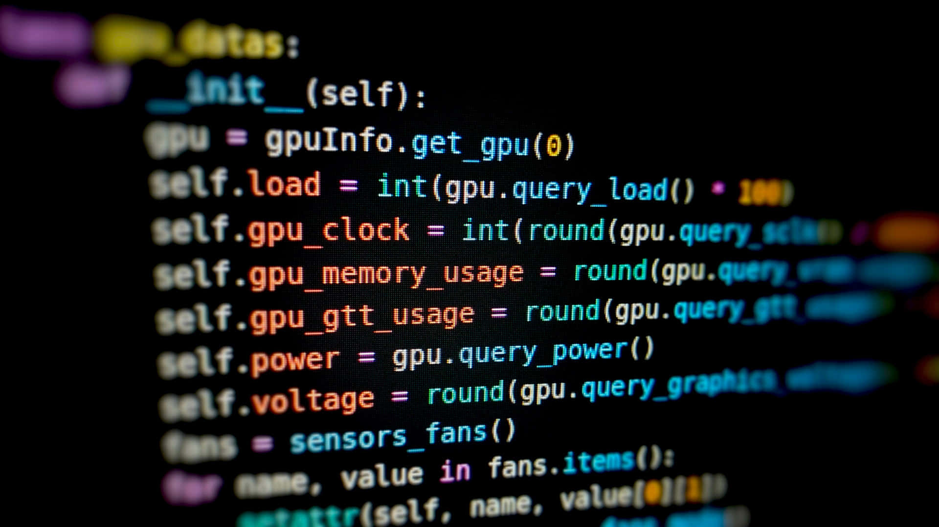
Technologies Used:
Coding Language:
Python
Tools:
Github

Slide 5

Project Draft Overview:
Title: Pitaka+: A Financial Tracker App
Project Objectives:
To develop a financial tracker/manager that can accurately and precisely record and categorize incomes and expenses in the Python coding language.
b. To provide real-time monitoring of said data to help users to reflect and build on their previous financial decisions and activities.
c. To hopefully benefit the user’s financial state by also providing other features that focus on other areas of finance such as budgeting
Problem Statement:
People sometimes find it hard to manually and accurately track and manage their finances, leading to poor financial decisions such as overbudgeting. A finance tracker and manager is required to record transactions, monitor your money and to make better and more responsible financial decisions.
Circumstances presented by the problem statement:
a. Difficulty in keeping an accurate record of your financial activities.
-Users may forget or misclassify any transactions they make, this can lead to inaccurate finance and budget calculations.
b.Difficulties in making wise and proper financial decisions due to the lack of accurate and precise tracking.
-Without proper tracking of financial actions such as transactions as well as their financial trends, users may struggle to save, budget or set saving goals.

Slide 6
Project Draft Overview(Planned Features):
Project Introduction:
Project Draft Overview:
Planned Flow:
User Authentication Phase
User enters username and password
If both are correct, then user is granted access to the main program
Main Program
Main Menu (gets displayed on loop):
Check Balance
Transaction Station
Transaction Archive
Budget Calculator
Currency Converter
Exit
Example Operations:
Transaction Station: User records 500 pesos income from stipend
Check Balance: Displays updated checking account of 500 pesos
Transaction Archive: Shows all income transactions
Budget Calculator: Calculates that user will earn 10,000 pesos given the income and expenses inputs
Currency Converter: 500 pesos gets converted to 8.58 USD
1. Checks and Balances
This feature aims to show you your current balance in either your checking or spending account or your savings account.
Automatically updates after every transaction done in the other features.
3. Transaction Archive
- Stores all transactions in chronological order
- Displays transaction information in a predefined format(Date of Transaction – short description)
Project Description:
5. Currency Converter
- This aims to convert the amount of pesos you have into a widely-used currency.
- Currencies supported:
a. United States Dollar
b. Euro
c. Japanese Yen
d. British Pound Sterling
e. Australian Dollar
f. Canadian Dollar
g. Singapore Dollar
h. South Korean Won
i. Chinese Yen
j. Hong Kong Dollar
k. Qatari Dirham
This is a simple Python project that helps you to accurately and precisely track your finances, such as your current balance as well as your transactions, among other things.
Project’s Objective:
a. To develop a financial tracker/manager that can accurately and precisely record and categorize incomes and expenses in the Python coding language.
b. To provide real-time monitoring of said data to help users to reflect and build on their previous financial decisions and activities.
c. To hopefully benefit the user’s financial state by also providing other features that focus on other areas of finance such as budgeting
2. Transaction Station
- Allows user to record financial activities such as income transactions and expense transactions.
- Required inputs include:
a. Date of Transaction: (year – month – day)
b. Account type to be used for transaction (checking/savings)
c. Type of transaction (income/expense)
d. Amount of pesos earned/lost
e. A brief description of the transaction
f. Optional: Physical or image proof of that transaction
- Updates balance automatically after transaction follows through
4. Balance Calculator
- Helps user figure out time needed to achieve a certain financial goal
- Formula used: (Target Balance) / (Monthly Income – Monthly Expense)
- If not a whole month, it rounds up to days
- Displays error message if expenses exceed income
Target Users:
The users targeted by this application are those in either financial distress or in need of precise and accurate financial tracking.

Slide 7
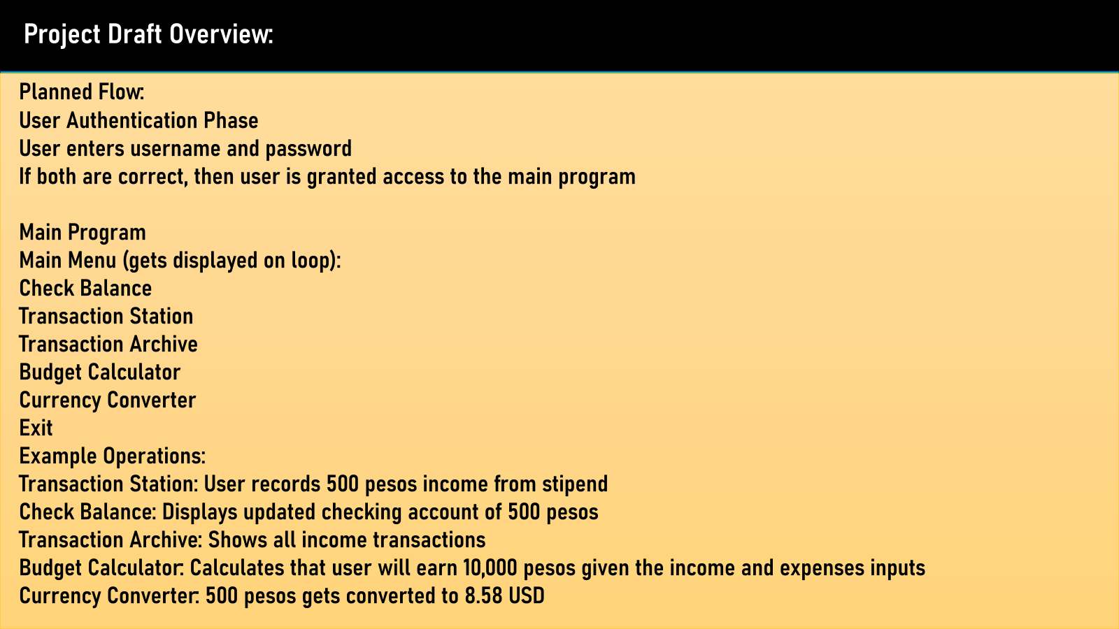
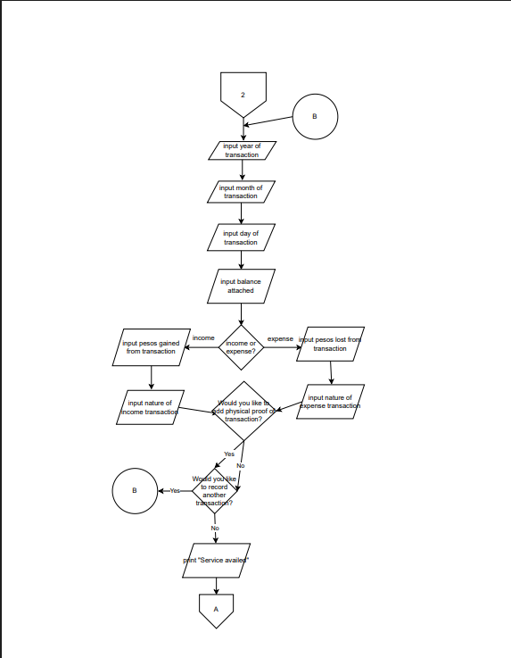
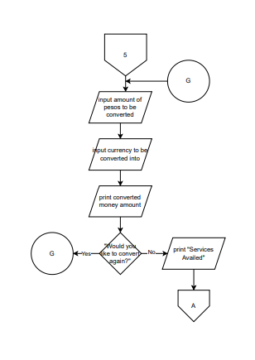
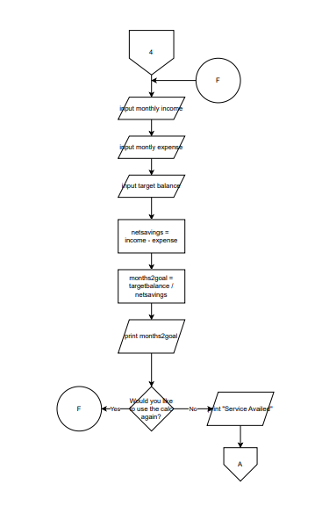
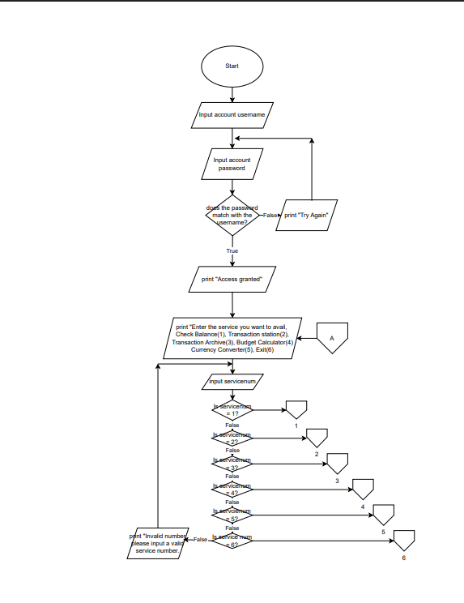
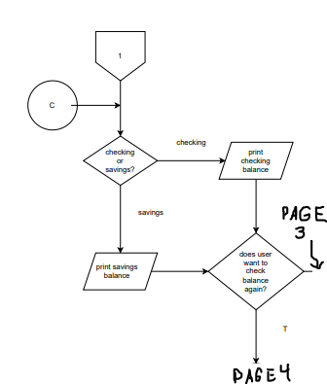
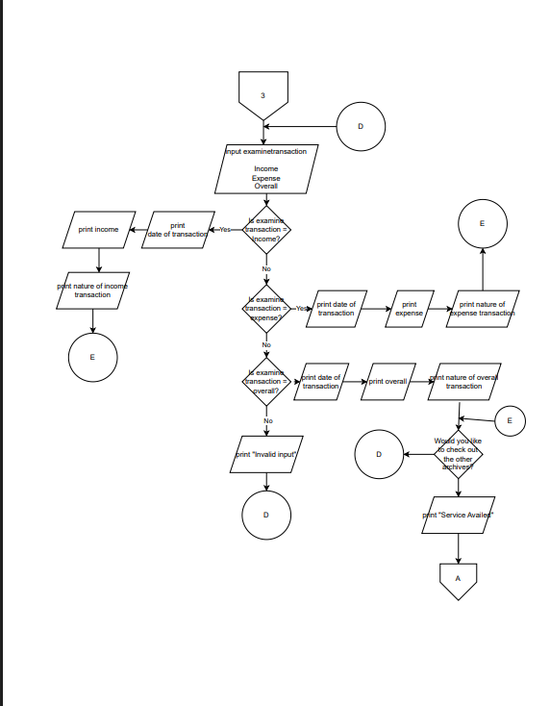
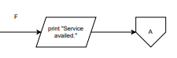
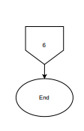
Flowchart
.
Page 2:
This page shows the logic plan and flow for the first feature: checks and balances, in which it asks the user if he wants to check his balance in the checking account or savings account, and it asks the user if he wants to use this feature again, it is a short yet effective feature. The following image also shows the message outputted after service has been availed
Page 5:
This final page of the flowchart highlights the final feature, the currency converter, as well as the finishing flowchart part in which the program / application itself ends.
Page 4:
This page features both logic plans for the third feature, the transaction archive, in which you can search for an expense based on a filter that separate income, expense and overall, as well as the fourth feature, the budget calculator, in which you can calculate on when you’ll be able to reach a certain financial goal using variables such as monthly income and monthly expenses.
Page 1:
This page of the flowchart shows the logic plan in which the authentication system, as proven by the decision symbol checking if password matches with account name. It also showcases the logic process in which the main menu works, highlighting the choice system as well as the program’s flow after you break the rules of the initial choice system
Page 3:
This page highlights the second feature of the program, which is the “Transaction Station”, in which you can record every transaction by, as shown in the flowchart, inputting the date of the transaction, the amount of money gained/lost, and the nature of the transaction as well as the option to attach physical evidence as well as the option to record another transaction, and the short dialogues that come afterwards.

Slide 8
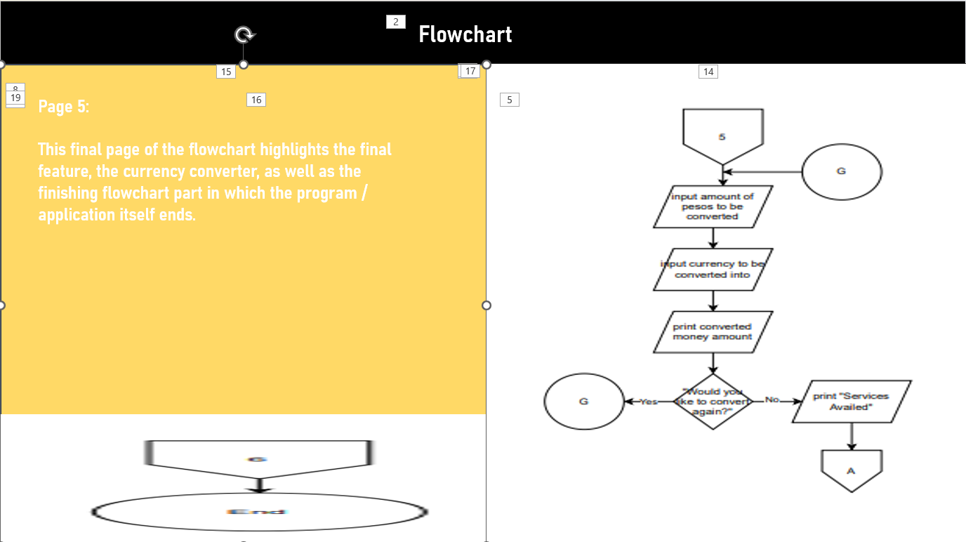
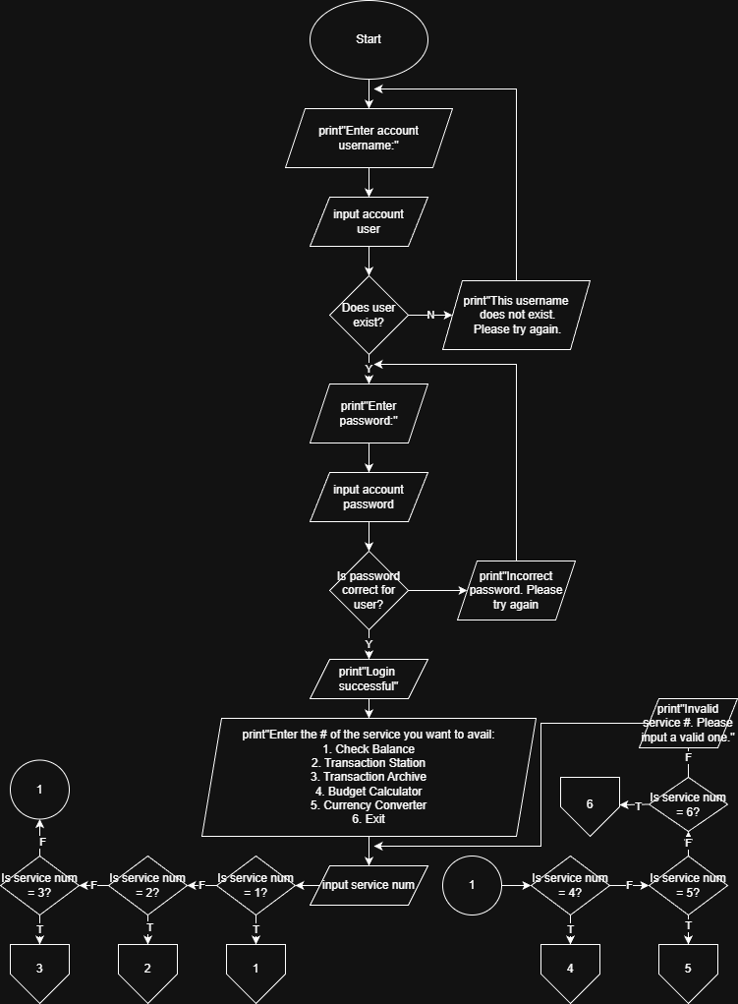
Process Flow Diagram
The Process Flow Diagram that you see before you is the expanded process and logic plan for the main menu, containing longer dialogues as well as a more organized and neater layout, as long with clearer messages when things go wrong

Slide 9
Plans for the Future:
To begin working on the code itself for the application
To finalize the project.

Slide 10



